Slide 1
Complex Data Analysis Improve your data analytic abilities using Stata and Early Grade Reading and Mathematics Assessment Data Sunday March 5, 8:30 – 14:45 Georgia 2 (South Tower) CIES 2017 Downtown Sheraton Atlanta, GA
Marissa Gargano
Sarrynna Sou
Susan Edwards
Chris Cummiskey
Marissa Gargano
Sarrynna Sou
Susan Edwards
Chris Cummiskey

Slide 2
Outline of Intervention Workshop
Introduce the PRIMR Study
Background
Establish and address direct aims
Difference-in-Difference (DiD) Values
Explain what a DiD is and how it’s calculated
Regressions
Set up models; Link DiD and t-tests calculations to the regression output

Slide 3
Overview of PRIMR Kenya Study
Scope
Apply innovative, data-based instructional improvement methods to increase students’ fundamental skills in reading and mathematics
Purpose
Create a sustainable reading and mathematics program could be implemented
Assessment tool EGRA-EGMA
Time frame
January 2012 – October 2013
Grades 1 and 2

Slide 4
Overview of Workshop Data Set
Subset of PRIMR Kenya study
C1 and C3
Oct 2012 – 2013
Grade 2
Midterm A will be our baseline
Disclaimer: Results from this workshop will not reflect published estimates from this study

Slide 5
Overview of Workshop Data Set
Treatment/ year | 2012 | 2013 | Total
Control | 377 | 400 | 777
Full Treatment | 536 | 522 | 1,058
 | 913 | 922 | 1,835
Gender/ Grade | Second
Male | 893
Female | 942
 | 1,835

Slide 6
Aims
Primary AIM
Did PRIMR have an effect on pupil achievement in reading and math?
“Did the treatment work?”
Secondary AIM
Was the treatment more effective in the public or non-formal schools?
Notes:
Did the treatment work?

Slide 7
Sample
How were the students sampled?
Do we resample at end line or use the same schools from baseline?
Intervention Assessment Only?
Resample not needed.
Another population level estimate?
Depends . . .
Is there concern about fidelity of implementation?
Assumption: No time changes in the population.

Slide 8
Baseline Sampling
Notes:
Variable is nonformal

Slide 9
10 minute break

Slide 10
Appending and Merging
Goal: Set up the final data set with baseline and endline data.
Problem:
We have two separate data sets
Baseline
Endline
How do we bring these data sets together in Stata?

Slide 11
Appending and Merging - WHEN
Append
Stacking Datasets – one long dataset
when you have separate baseline, midterm, or end line data
Merge
Linking Datasets – one wide dataset
Same students are tested in two different languages
School Level Demographics (SSME)
Longitudinal
Notes:
Set Up Data

Slide 12
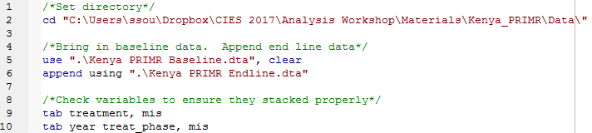
Appending and Merging – APPENDING IN STATA
Example Code:

Slide 13
Address Aims
Goal: Address the following aims by calculating simple baseline and end line comparisons.
Did PRIMR have an effect on pupil achievement in reading and math?
Was the treatment more effective in the public or non-formal schools?
Notes:
What do we want to compare?
How do we compare these different groups?
Control/ Treatment
Gender
School type
Rural/ urban

Slide 14
Simple Comparisons
Null Hypothesis
No difference between the two groups in question
Alternative Hypothesis
There is a significant difference between the two groups in question
Rejection Level (Alpha Level)
The probability of the difference not occurring due to chance
Test Statistic
Level of Significance (p-value)
Notes:
Null Hypothesis- there is no significant difference between the two groups in question
Alternative Hypothesis- there is significant difference due to an effect
Rejection Level (Alpha Level)- .01, .05, .10
Test Statistic- t –test in this case- used in the hypothesis test to determine significance
Level of Significance (p-value)- what is the p value that the t test yields?

Slide 15
Simple Comparisons Activity
Activity:
Please open up do file
\\Kenya PRIMR Comparison Activity.do
There is a list of questions to help guide you through calculating weighted simple comparisons
Notes:
SVY comment

Slide 16
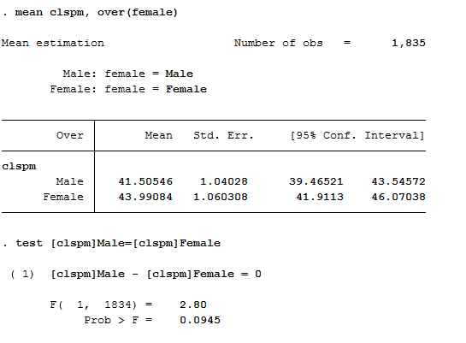
Example in Do File

Slide 17
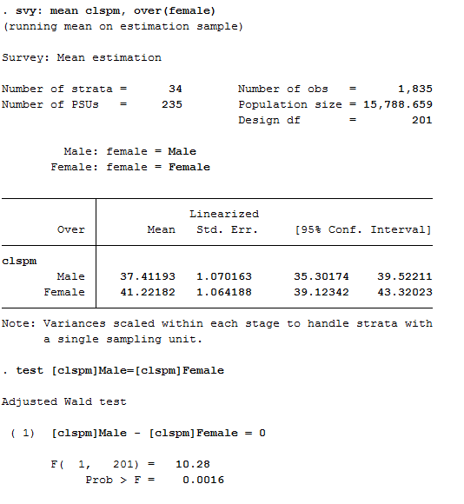
Example in Do File
Notes:
Look at the differences!!!!!!!!!

Slide 18
Discussion
What did you find most interesting from these comparisons?
Were there issues you came across during the activity? If so, may you state them?
We see that there a differences between mean values, now how do we measure how big these differences are?

Slide 19

10 Minute Break?

